Slide 1
PONTIFÍCIA UNIVERSIDADE CATÓLICA DE SÃO PAULO
CURSO DE ESPECIALIZAÇÃO EM ENGENHARIA DE SOFTWARE
Modelagem de Software
Orientado a Objetos
Modelagem de Software
Orientado a Objetos
Parte 3 – Análise de Modelos de Software
Prof. Maurício Nacib Pontuschka
tuska@pucsp.br

Slide 2
Objetivos
Modelagem de Software Orientado a Objetos
Análise de Modelos de Software
Exercitar a elaboração de modelos de software explorando características sintáticas e semânticas nos diagramas da UML.
Interpretar modelos diagramados com a UML.
Destacar erros de sintaxe e de semântica em diagramas UML mais especificamente em diagramas de casos de uso e diagramas de seqüência de mensagens.
Notes:
Introduce the objectives for this module.

Slide 3
Fórum de Discussões
Modelagem de Software Orientado a Objetos
Análise de Modelos de Software
O sistema Fórum de Notícias permite que questões sejam postadas e permite que várias respostas sejam anexadas a cada questão. O diagrama acima identifica os casos de uso previstos para o software.
Qualquer usuário assume o mesmo papel ao utilizar o sistema por tanto todas as funcionalidades estarão disponíveis para qualquer usuário do sistema.
Como se trata de um sistema cujo foco é a modelagem e não efetivamente sua usabilidade, foram descartados aspectos importantes como persistência (armazenamento em disco) das informações entre outras tantas possíveis funcionalidades aderentes ao projeto.
Notes:
A communication diagram shows how objects interact to perform the behavior of a particular use case or a part of a use case.
Like sequence diagrams, communication diagrams are used by designers to define and clarify the roles of the objects that perform a particular flow of events of a use case. They are the primary source of information used to determine class responsibilities and interfaces.
Because of the communication diagram’s format, they tend to be better suited for analysis activities. Specifically, they tend to be better suited to depict simpler interactions of a smaller number of objects.
As the number of objects and messages grows, the diagram becomes increasingly hard to read. It is also difficult to show additional descriptive information like timing, decision points, or other unstructured information that can be easily added to the notes in a sequence diagram.
Unlike sequence diagrams, communication diagrams emphasize the organization of the objects.
Sequence diagrams, on the other hand, emphasize the time ordering of the messages.

Slide 4
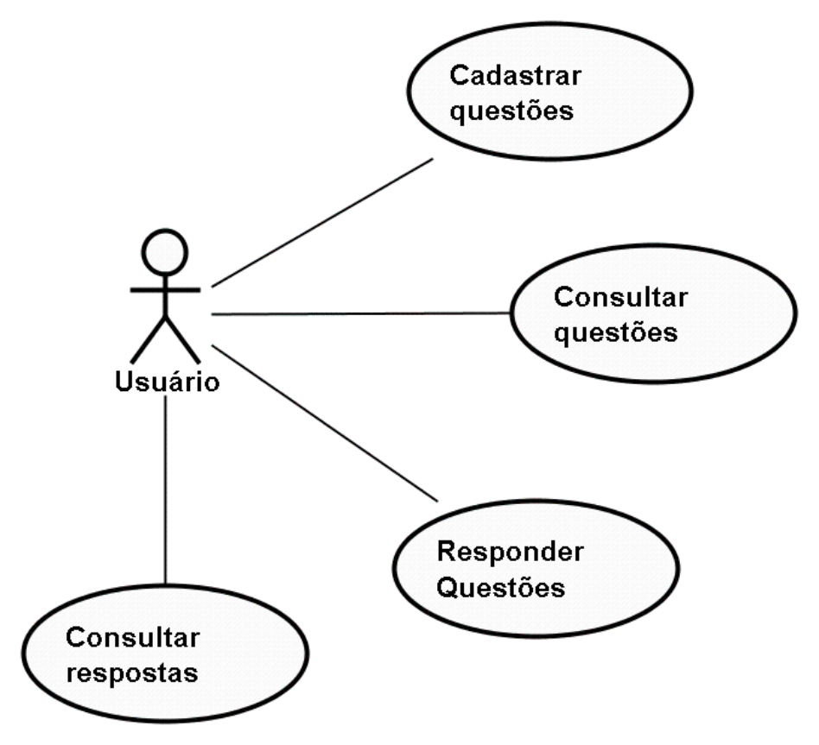
Jogo da Velha
Modelagem de Software Orientado a Objetos
Análise de Modelos de Software
Diagrama de casos de uso
Cadastrar questões
Este caso de uso representa a necessidade de um usuário publicar uma questão de seu interesse para compartilhar com outros usuários e futuramente, poder consultar suas respostas. Cada questão é colocada de forma independente sem qualquer tipo de classificação ou conferência.
Notes:
A communication diagram shows how objects interact to perform the behavior of a particular use case or a part of a use case.
Like sequence diagrams, communication diagrams are used by designers to define and clarify the roles of the objects that perform a particular flow of events of a use case. They are the primary source of information used to determine class responsibilities and interfaces.
Because of the communication diagram’s format, they tend to be better suited for analysis activities. Specifically, they tend to be better suited to depict simpler interactions of a smaller number of objects.
As the number of objects and messages grows, the diagram becomes increasingly hard to read. It is also difficult to show additional descriptive information like timing, decision points, or other unstructured information that can be easily added to the notes in a sequence diagram.
Unlike sequence diagrams, communication diagrams emphasize the organization of the objects.
Sequence diagrams, on the other hand, emphasize the time ordering of the messages.

Slide 5
Jogo da Velha
Modelagem de Software Orientado a Objetos
Análise de Modelos de Software
Diagrama de casos de uso
Consultar questões
Um usuário pode percorrer a lista de questões a fim de verificar temas de interesse de outros usuários e até verificar se alguma questão é de seu interesse tanto na leitura das respostas como até, eventualmente, contribuir com sua resposta no futuro.
Notes:
A communication diagram shows how objects interact to perform the behavior of a particular use case or a part of a use case.
Like sequence diagrams, communication diagrams are used by designers to define and clarify the roles of the objects that perform a particular flow of events of a use case. They are the primary source of information used to determine class responsibilities and interfaces.
Because of the communication diagram’s format, they tend to be better suited for analysis activities. Specifically, they tend to be better suited to depict simpler interactions of a smaller number of objects.
As the number of objects and messages grows, the diagram becomes increasingly hard to read. It is also difficult to show additional descriptive information like timing, decision points, or other unstructured information that can be easily added to the notes in a sequence diagram.
Unlike sequence diagrams, communication diagrams emphasize the organization of the objects.
Sequence diagrams, on the other hand, emphasize the time ordering of the messages.

Slide 6
Jogo da Velha
Modelagem de Software Orientado a Objetos
Análise de Modelos de Software
Diagrama de casos de uso
Responder questões
Um usuário pode registrar sua opinião a respeito de temas levantados por outros usuários do Fórum de Notícias. A sua resposta é anexada à questão e é disponibilizada para qualquer outro usuário.
Notes:
A communication diagram shows how objects interact to perform the behavior of a particular use case or a part of a use case.
Like sequence diagrams, communication diagrams are used by designers to define and clarify the roles of the objects that perform a particular flow of events of a use case. They are the primary source of information used to determine class responsibilities and interfaces.
Because of the communication diagram’s format, they tend to be better suited for analysis activities. Specifically, they tend to be better suited to depict simpler interactions of a smaller number of objects.
As the number of objects and messages grows, the diagram becomes increasingly hard to read. It is also difficult to show additional descriptive information like timing, decision points, or other unstructured information that can be easily added to the notes in a sequence diagram.
Unlike sequence diagrams, communication diagrams emphasize the organization of the objects.
Sequence diagrams, on the other hand, emphasize the time ordering of the messages.

Slide 7
Jogo da Velha
Modelagem de Software Orientado a Objetos
Análise de Modelos de Software
Diagrama de casos de uso
Consultar respostas
O usuário pode se interessar em ler as respostas de questões postadas ou não por ele. Caso tenha interesse, ele poderá navegar pelas questões do Fórum e consultar as várias possíveis respostas anexadas a cada questão.
Notes:
A communication diagram shows how objects interact to perform the behavior of a particular use case or a part of a use case.
Like sequence diagrams, communication diagrams are used by designers to define and clarify the roles of the objects that perform a particular flow of events of a use case. They are the primary source of information used to determine class responsibilities and interfaces.
Because of the communication diagram’s format, they tend to be better suited for analysis activities. Specifically, they tend to be better suited to depict simpler interactions of a smaller number of objects.
As the number of objects and messages grows, the diagram becomes increasingly hard to read. It is also difficult to show additional descriptive information like timing, decision points, or other unstructured information that can be easily added to the notes in a sequence diagram.
Unlike sequence diagrams, communication diagrams emphasize the organization of the objects.
Sequence diagrams, on the other hand, emphasize the time ordering of the messages.

Slide 8
Fórum de Discussões
Modelagem de Software Orientado a Objetos
Análise de Modelos de Software
MN#01 – Caso de Uso Cadastrar Questões
Ator Principal: Usuário
Pré-condições Nenhuma
Pós-Condições: Questão Cadastrada
1. Seleciona a opção de cadastrar uma nova questão.
 | 2. Exibe uma tela para a redação da nova questão com os campos: nome do usuário e questão. A data e a hora serão armazenadas automaticamente juntamente com os dados de entrada do usuário.
3. Digita as informações da tela e submete a questão para o Fórum de Discussão.
 | 4. Acrescenta a questão do usuário no sistema.
Notes:
A communication diagram shows how objects interact to perform the behavior of a particular use case or a part of a use case.
Like sequence diagrams, communication diagrams are used by designers to define and clarify the roles of the objects that perform a particular flow of events of a use case. They are the primary source of information used to determine class responsibilities and interfaces.
Because of the communication diagram’s format, they tend to be better suited for analysis activities. Specifically, they tend to be better suited to depict simpler interactions of a smaller number of objects.
As the number of objects and messages grows, the diagram becomes increasingly hard to read. It is also difficult to show additional descriptive information like timing, decision points, or other unstructured information that can be easily added to the notes in a sequence diagram.
Unlike sequence diagrams, communication diagrams emphasize the organization of the objects.
Sequence diagrams, on the other hand, emphasize the time ordering of the messages.

Slide 9
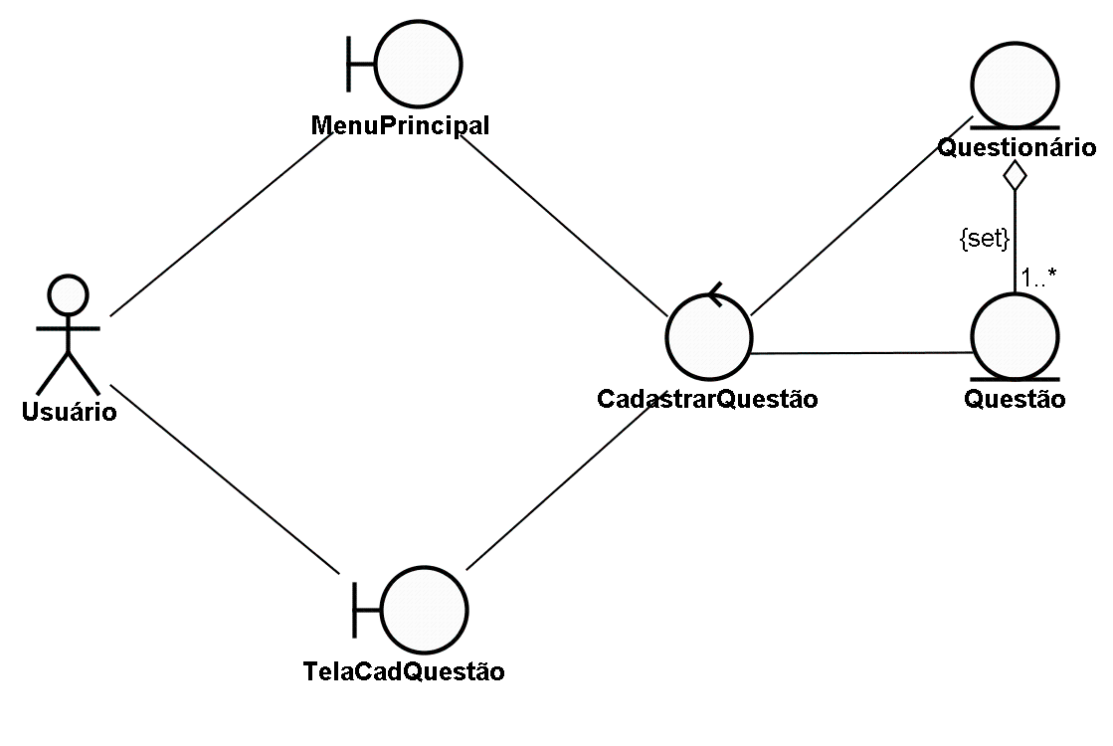
Fórum de Discussões
Modelagem de Software Orientado a Objetos
Análise de Modelos de Software
Diagrama de Robustez para o caso de uso Cadastrar Questões
Notes:
A communication diagram shows how objects interact to perform the behavior of a particular use case or a part of a use case.
Like sequence diagrams, communication diagrams are used by designers to define and clarify the roles of the objects that perform a particular flow of events of a use case. They are the primary source of information used to determine class responsibilities and interfaces.
Because of the communication diagram’s format, they tend to be better suited for analysis activities. Specifically, they tend to be better suited to depict simpler interactions of a smaller number of objects.
As the number of objects and messages grows, the diagram becomes increasingly hard to read. It is also difficult to show additional descriptive information like timing, decision points, or other unstructured information that can be easily added to the notes in a sequence diagram.
Unlike sequence diagrams, communication diagrams emphasize the organization of the objects.
Sequence diagrams, on the other hand, emphasize the time ordering of the messages.

Slide 10
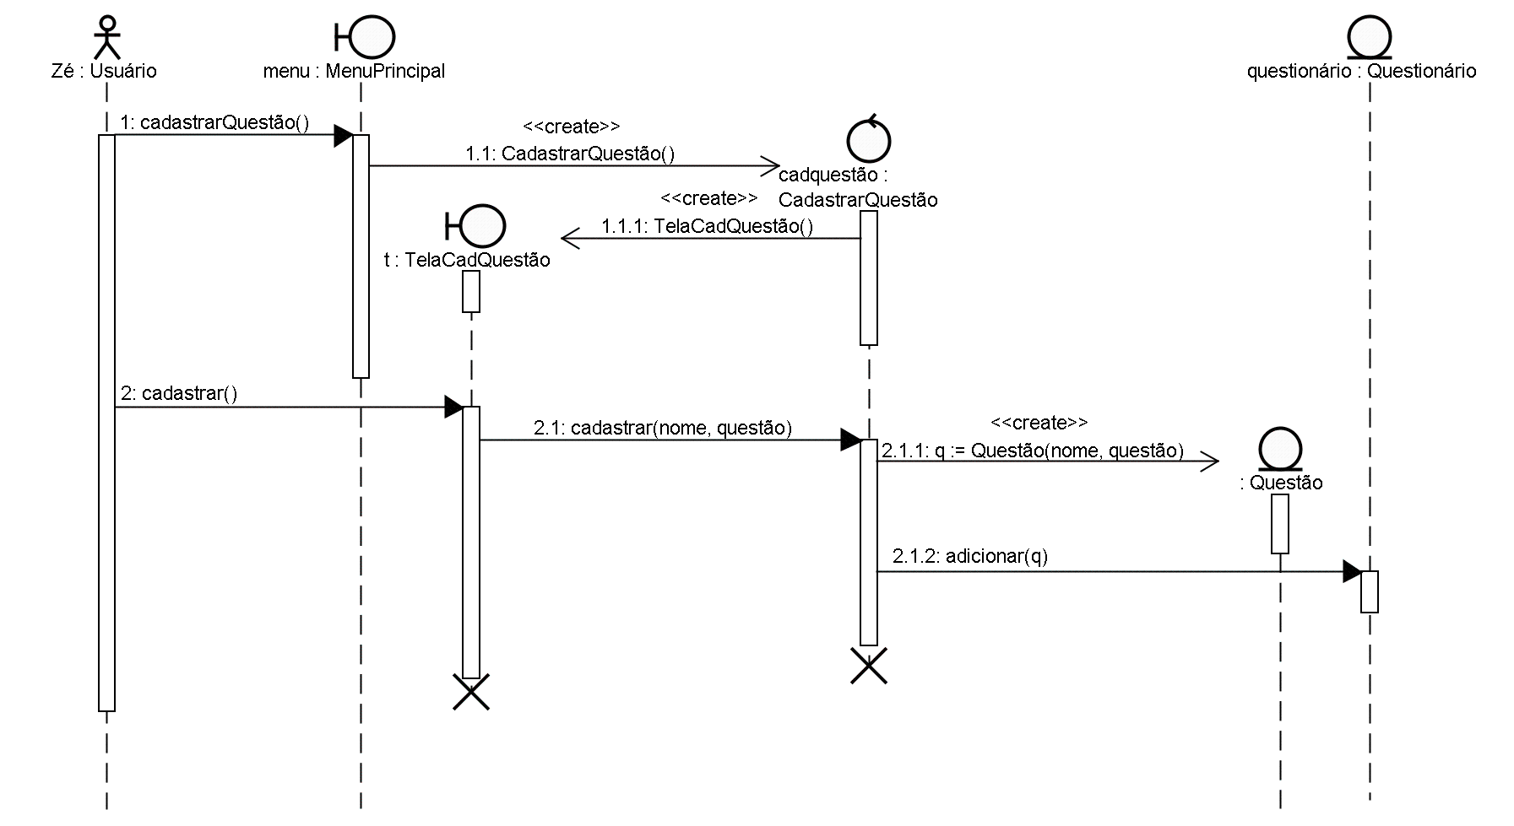
Fórum de Discussões
Modelagem de Software Orientado a Objetos
Análise de Modelos de Software
Diagrama de Seqüência para o caso de uso Cadastrar Questões
Notes:
A communication diagram shows how objects interact to perform the behavior of a particular use case or a part of a use case.
Like sequence diagrams, communication diagrams are used by designers to define and clarify the roles of the objects that perform a particular flow of events of a use case. They are the primary source of information used to determine class responsibilities and interfaces.
Because of the communication diagram’s format, they tend to be better suited for analysis activities. Specifically, they tend to be better suited to depict simpler interactions of a smaller number of objects.
As the number of objects and messages grows, the diagram becomes increasingly hard to read. It is also difficult to show additional descriptive information like timing, decision points, or other unstructured information that can be easily added to the notes in a sequence diagram.
Unlike sequence diagrams, communication diagrams emphasize the organization of the objects.
Sequence diagrams, on the other hand, emphasize the time ordering of the messages.

Slide 11
Fórum de Discussões
Modelagem de Software Orientado a Objetos
Análise de Modelos de Software
MN#02 – Caso de Uso Consultar Questões
Ator Principal: Usuário
Pré-condições Nenhuma
Pós-Condições: Questões consultadas
1. Seleciona a opção de consultar questões.
 | 2. Exibe uma tela com a lista de todas as questões já cadastradas no sistema.
3. Consulta as questões cadastradas e depois solicita a volta ao menu principal.
 | 4. Fecha a tela de consulta.
Notes:
A communication diagram shows how objects interact to perform the behavior of a particular use case or a part of a use case.
Like sequence diagrams, communication diagrams are used by designers to define and clarify the roles of the objects that perform a particular flow of events of a use case. They are the primary source of information used to determine class responsibilities and interfaces.
Because of the communication diagram’s format, they tend to be better suited for analysis activities. Specifically, they tend to be better suited to depict simpler interactions of a smaller number of objects.
As the number of objects and messages grows, the diagram becomes increasingly hard to read. It is also difficult to show additional descriptive information like timing, decision points, or other unstructured information that can be easily added to the notes in a sequence diagram.
Unlike sequence diagrams, communication diagrams emphasize the organization of the objects.
Sequence diagrams, on the other hand, emphasize the time ordering of the messages.

Slide 12
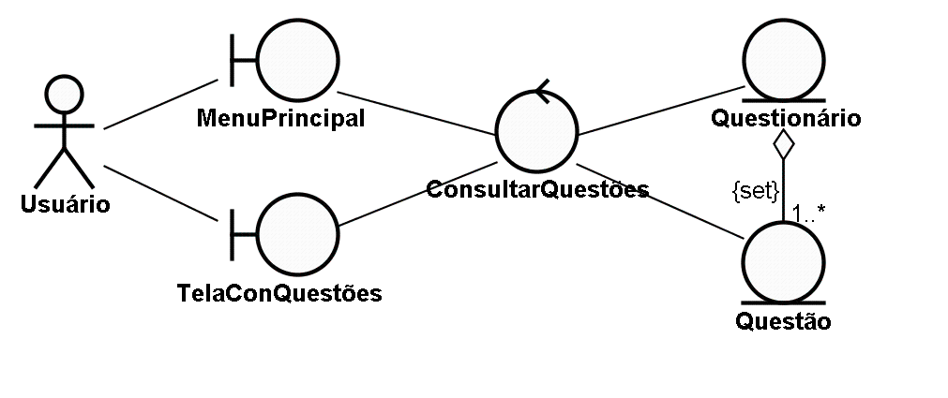
Fórum de Discussões
Modelagem de Software Orientado a Objetos
Análise de Modelos de Software
Diagrama de Robustez para o caso de uso Consultar Questões
Notes:
A communication diagram shows how objects interact to perform the behavior of a particular use case or a part of a use case.
Like sequence diagrams, communication diagrams are used by designers to define and clarify the roles of the objects that perform a particular flow of events of a use case. They are the primary source of information used to determine class responsibilities and interfaces.
Because of the communication diagram’s format, they tend to be better suited for analysis activities. Specifically, they tend to be better suited to depict simpler interactions of a smaller number of objects.
As the number of objects and messages grows, the diagram becomes increasingly hard to read. It is also difficult to show additional descriptive information like timing, decision points, or other unstructured information that can be easily added to the notes in a sequence diagram.
Unlike sequence diagrams, communication diagrams emphasize the organization of the objects.
Sequence diagrams, on the other hand, emphasize the time ordering of the messages.

Slide 13
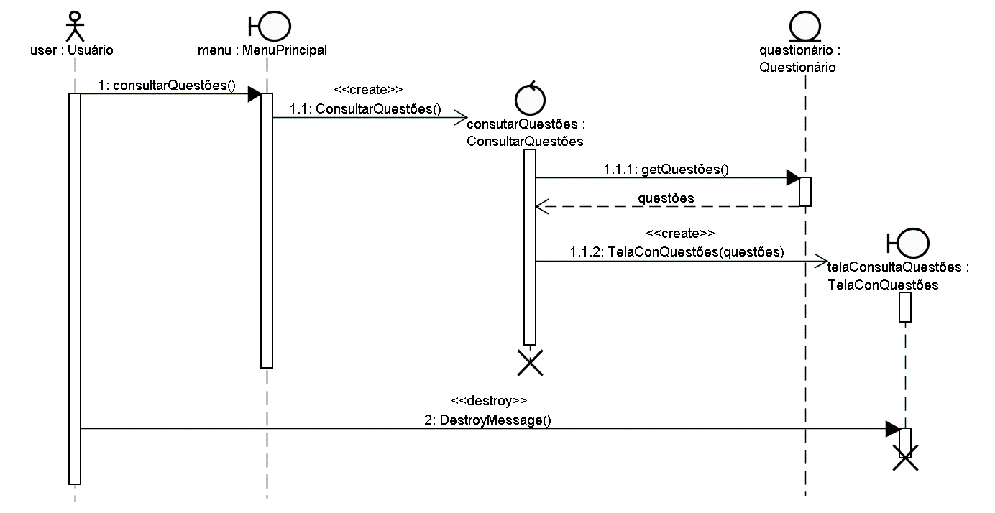
Fórum de Discussões
Modelagem de Software Orientado a Objetos
Análise de Modelos de Software
Diagrama de Seqüência para o caso de uso Consultar Questões
Notes:
A communication diagram shows how objects interact to perform the behavior of a particular use case or a part of a use case.
Like sequence diagrams, communication diagrams are used by designers to define and clarify the roles of the objects that perform a particular flow of events of a use case. They are the primary source of information used to determine class responsibilities and interfaces.
Because of the communication diagram’s format, they tend to be better suited for analysis activities. Specifically, they tend to be better suited to depict simpler interactions of a smaller number of objects.
As the number of objects and messages grows, the diagram becomes increasingly hard to read. It is also difficult to show additional descriptive information like timing, decision points, or other unstructured information that can be easily added to the notes in a sequence diagram.
Unlike sequence diagrams, communication diagrams emphasize the organization of the objects.
Sequence diagrams, on the other hand, emphasize the time ordering of the messages.

Slide 14
Fórum de Discussões
Modelagem de Software Orientado a Objetos
Análise de Modelos de Software
MN#03 – Caso de Uso Responder Questão
Ator Principal: Usuário
Pré-condições: Questão cadastrada
Pós-Condições: Questão com resposta anexada
1. Seleciona a opção de responder uma questão.
 | 2. Exibe uma tela com todas as questões para que o usuário escolha a questão a ser respondida.
3. Escolhe uma das questões apresentadas na tela.
 | 4. Apresenta uma tela com a pergunta escolhida e um espaço para que o usuário preencha seu nome e resposta para a questão.
5. Preenche seu nome e a resposta à questão.
 | 6. Registra o nome, a resposta, a data e a hora do sistema e anexa à questão.
Notes:
A communication diagram shows how objects interact to perform the behavior of a particular use case or a part of a use case.
Like sequence diagrams, communication diagrams are used by designers to define and clarify the roles of the objects that perform a particular flow of events of a use case. They are the primary source of information used to determine class responsibilities and interfaces.
Because of the communication diagram’s format, they tend to be better suited for analysis activities. Specifically, they tend to be better suited to depict simpler interactions of a smaller number of objects.
As the number of objects and messages grows, the diagram becomes increasingly hard to read. It is also difficult to show additional descriptive information like timing, decision points, or other unstructured information that can be easily added to the notes in a sequence diagram.
Unlike sequence diagrams, communication diagrams emphasize the organization of the objects.
Sequence diagrams, on the other hand, emphasize the time ordering of the messages.

Slide 15
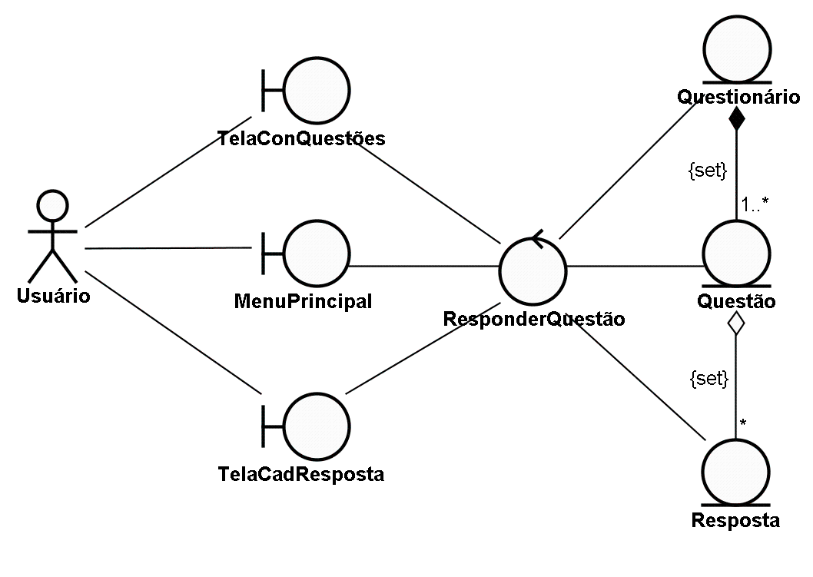
Fórum de Discussões
Modelagem de Software Orientado a Objetos
Análise de Modelos de Software
Diagrama de Robustez para o caso de uso Responder Questões
Notes:
A communication diagram shows how objects interact to perform the behavior of a particular use case or a part of a use case.
Like sequence diagrams, communication diagrams are used by designers to define and clarify the roles of the objects that perform a particular flow of events of a use case. They are the primary source of information used to determine class responsibilities and interfaces.
Because of the communication diagram’s format, they tend to be better suited for analysis activities. Specifically, they tend to be better suited to depict simpler interactions of a smaller number of objects.
As the number of objects and messages grows, the diagram becomes increasingly hard to read. It is also difficult to show additional descriptive information like timing, decision points, or other unstructured information that can be easily added to the notes in a sequence diagram.
Unlike sequence diagrams, communication diagrams emphasize the organization of the objects.
Sequence diagrams, on the other hand, emphasize the time ordering of the messages.

Slide 16
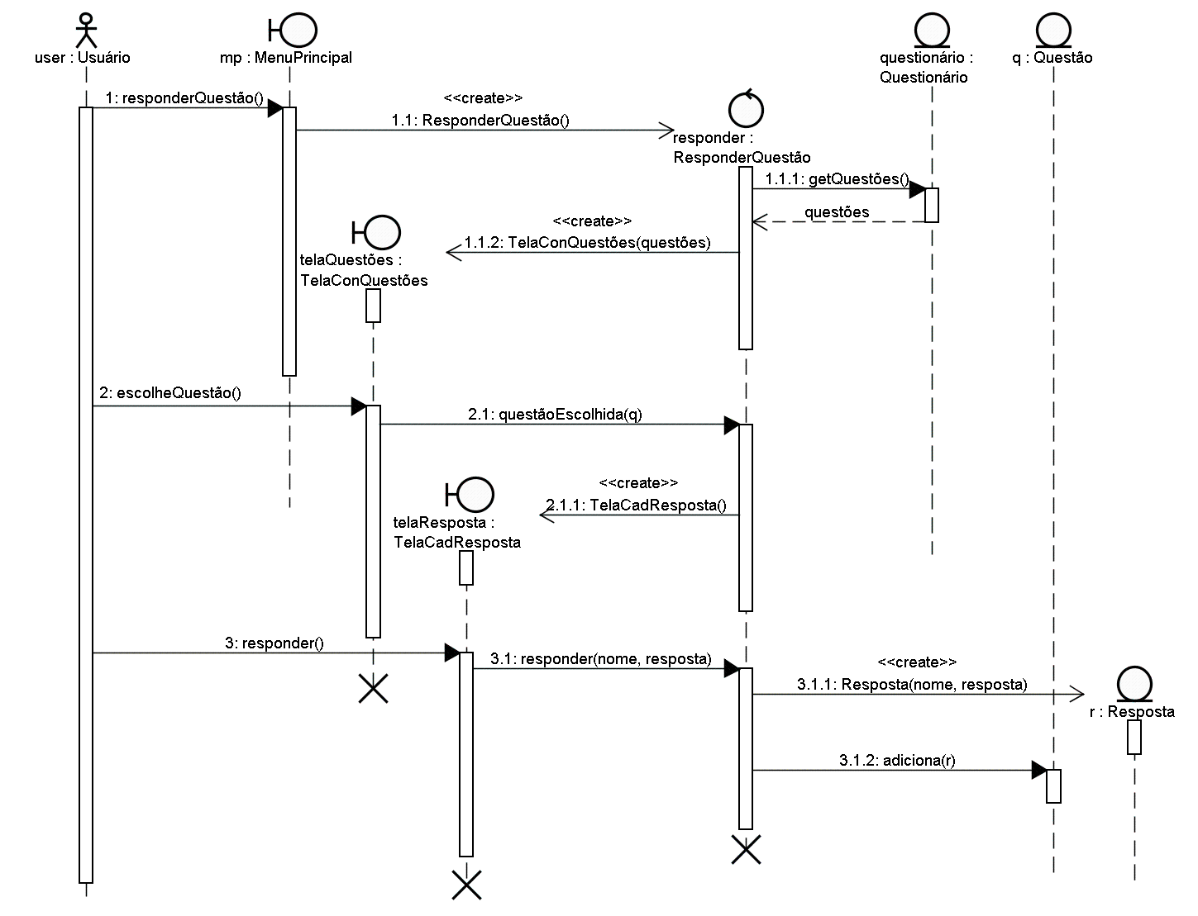
Fórum de Discussões
Modelagem de Software Orientado a Objetos
Análise de Modelos de Software
Diagrama de Robustez para o caso de uso Responder Questões
Notes:
A communication diagram shows how objects interact to perform the behavior of a particular use case or a part of a use case.
Like sequence diagrams, communication diagrams are used by designers to define and clarify the roles of the objects that perform a particular flow of events of a use case. They are the primary source of information used to determine class responsibilities and interfaces.
Because of the communication diagram’s format, they tend to be better suited for analysis activities. Specifically, they tend to be better suited to depict simpler interactions of a smaller number of objects.
As the number of objects and messages grows, the diagram becomes increasingly hard to read. It is also difficult to show additional descriptive information like timing, decision points, or other unstructured information that can be easily added to the notes in a sequence diagram.
Unlike sequence diagrams, communication diagrams emphasize the organization of the objects.
Sequence diagrams, on the other hand, emphasize the time ordering of the messages.

Slide 17
Fórum de Discussões
Modelagem de Software Orientado a Objetos
Análise de Modelos de Software
MN#04 – Caso de Uso Consultar Respostas das Questões
Ator Principal: Usuário
Pré-condições: Questão cadastrada
Pós-Condições: Respostas da questão consultadas
1. Seleciona a opção de consultar respostas de uma questão.
 | 2. Exibe uma tela com todas as questões para que o usuário escolha a questão para a consulta de suas respostas.
3. Escolhe uma das questões apresentadas na tela.
 | 4. Apresenta uma tela com a pergunta escolhida e todas as respostas associadas à esta questão.
5. Consulta as respostas associadas à questão e depois solicita a volta ao menu principal.
 | 6. Fecha a tela de consulta de respostas.
Notes:
A communication diagram shows how objects interact to perform the behavior of a particular use case or a part of a use case.
Like sequence diagrams, communication diagrams are used by designers to define and clarify the roles of the objects that perform a particular flow of events of a use case. They are the primary source of information used to determine class responsibilities and interfaces.
Because of the communication diagram’s format, they tend to be better suited for analysis activities. Specifically, they tend to be better suited to depict simpler interactions of a smaller number of objects.
As the number of objects and messages grows, the diagram becomes increasingly hard to read. It is also difficult to show additional descriptive information like timing, decision points, or other unstructured information that can be easily added to the notes in a sequence diagram.
Unlike sequence diagrams, communication diagrams emphasize the organization of the objects.
Sequence diagrams, on the other hand, emphasize the time ordering of the messages.

Slide 18
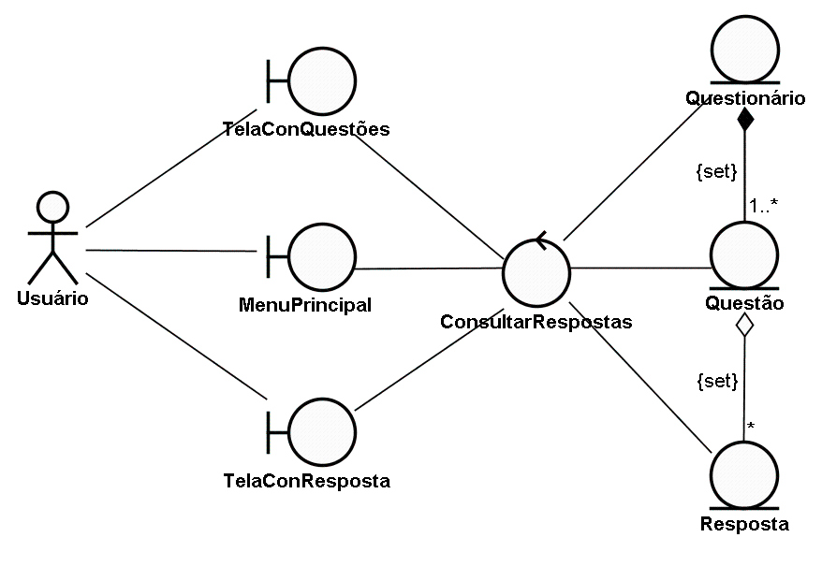
Fórum de Discussões
Modelagem de Software Orientado a Objetos
Análise de Modelos de Software
Diagrama de Robustez para o caso de uso Consultar Respostas das Questões
Notes:
A communication diagram shows how objects interact to perform the behavior of a particular use case or a part of a use case.
Like sequence diagrams, communication diagrams are used by designers to define and clarify the roles of the objects that perform a particular flow of events of a use case. They are the primary source of information used to determine class responsibilities and interfaces.
Because of the communication diagram’s format, they tend to be better suited for analysis activities. Specifically, they tend to be better suited to depict simpler interactions of a smaller number of objects.
As the number of objects and messages grows, the diagram becomes increasingly hard to read. It is also difficult to show additional descriptive information like timing, decision points, or other unstructured information that can be easily added to the notes in a sequence diagram.
Unlike sequence diagrams, communication diagrams emphasize the organization of the objects.
Sequence diagrams, on the other hand, emphasize the time ordering of the messages.

Slide 19
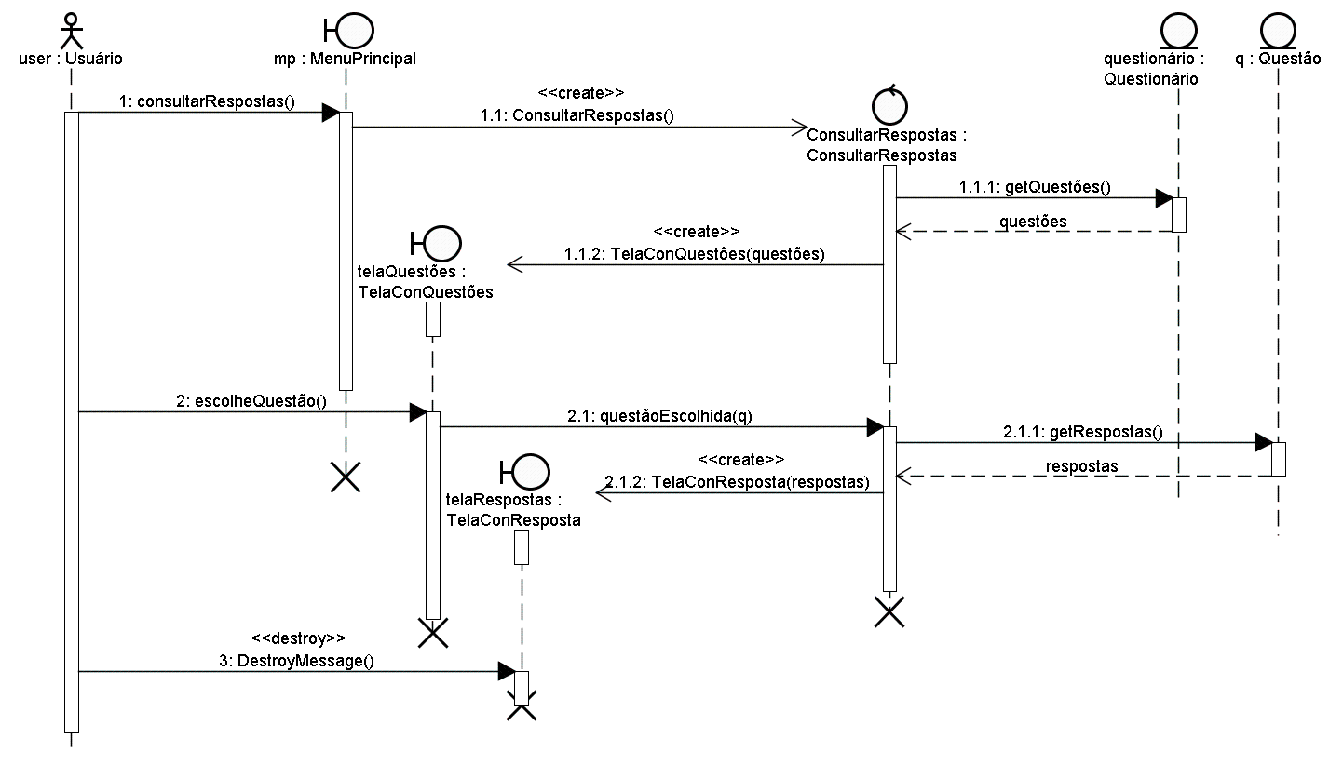
Fórum de Discussões
Modelagem de Software Orientado a Objetos
Análise de Modelos de Software
Diagrama de Seqüência para o caso de uso Consultar Respostas das Questões
Notes:
A communication diagram shows how objects interact to perform the behavior of a particular use case or a part of a use case.
Like sequence diagrams, communication diagrams are used by designers to define and clarify the roles of the objects that perform a particular flow of events of a use case. They are the primary source of information used to determine class responsibilities and interfaces.
Because of the communication diagram’s format, they tend to be better suited for analysis activities. Specifically, they tend to be better suited to depict simpler interactions of a smaller number of objects.
As the number of objects and messages grows, the diagram becomes increasingly hard to read. It is also difficult to show additional descriptive information like timing, decision points, or other unstructured information that can be easily added to the notes in a sequence diagram.
Unlike sequence diagrams, communication diagrams emphasize the organization of the objects.
Sequence diagrams, on the other hand, emphasize the time ordering of the messages.

Slide 20
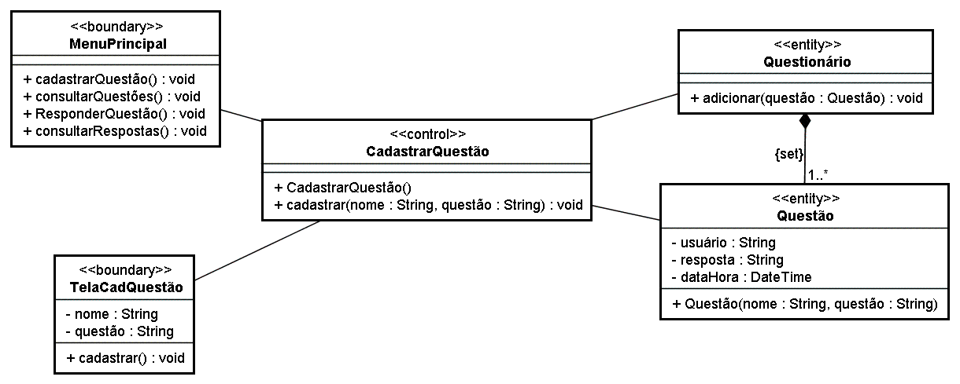
Fórum de Discussões
Modelagem de Software Orientado a Objetos
Análise de Modelos de Software
Refinamento do diagrama de classes
Caso de Uso Cadastrar Questão
Notes:
A communication diagram shows how objects interact to perform the behavior of a particular use case or a part of a use case.
Like sequence diagrams, communication diagrams are used by designers to define and clarify the roles of the objects that perform a particular flow of events of a use case. They are the primary source of information used to determine class responsibilities and interfaces.
Because of the communication diagram’s format, they tend to be better suited for analysis activities. Specifically, they tend to be better suited to depict simpler interactions of a smaller number of objects.
As the number of objects and messages grows, the diagram becomes increasingly hard to read. It is also difficult to show additional descriptive information like timing, decision points, or other unstructured information that can be easily added to the notes in a sequence diagram.
Unlike sequence diagrams, communication diagrams emphasize the organization of the objects.
Sequence diagrams, on the other hand, emphasize the time ordering of the messages.

Slide 21
Modelagem de Software Orientado a Objetos
Análise de Modelos de Software
Dúvidas?

